Slide 1
Poisonous
Studente/i
Relatore
Correlatore
Denis Beqiraj, Lorenzo Ronzani
Corso di laurea
Modulo / Codice Progetto
Anno
Ingegneria Informatica
2021/2022
Committente
Data
Masiar Babazadeh
04/02/2022

Slide 2
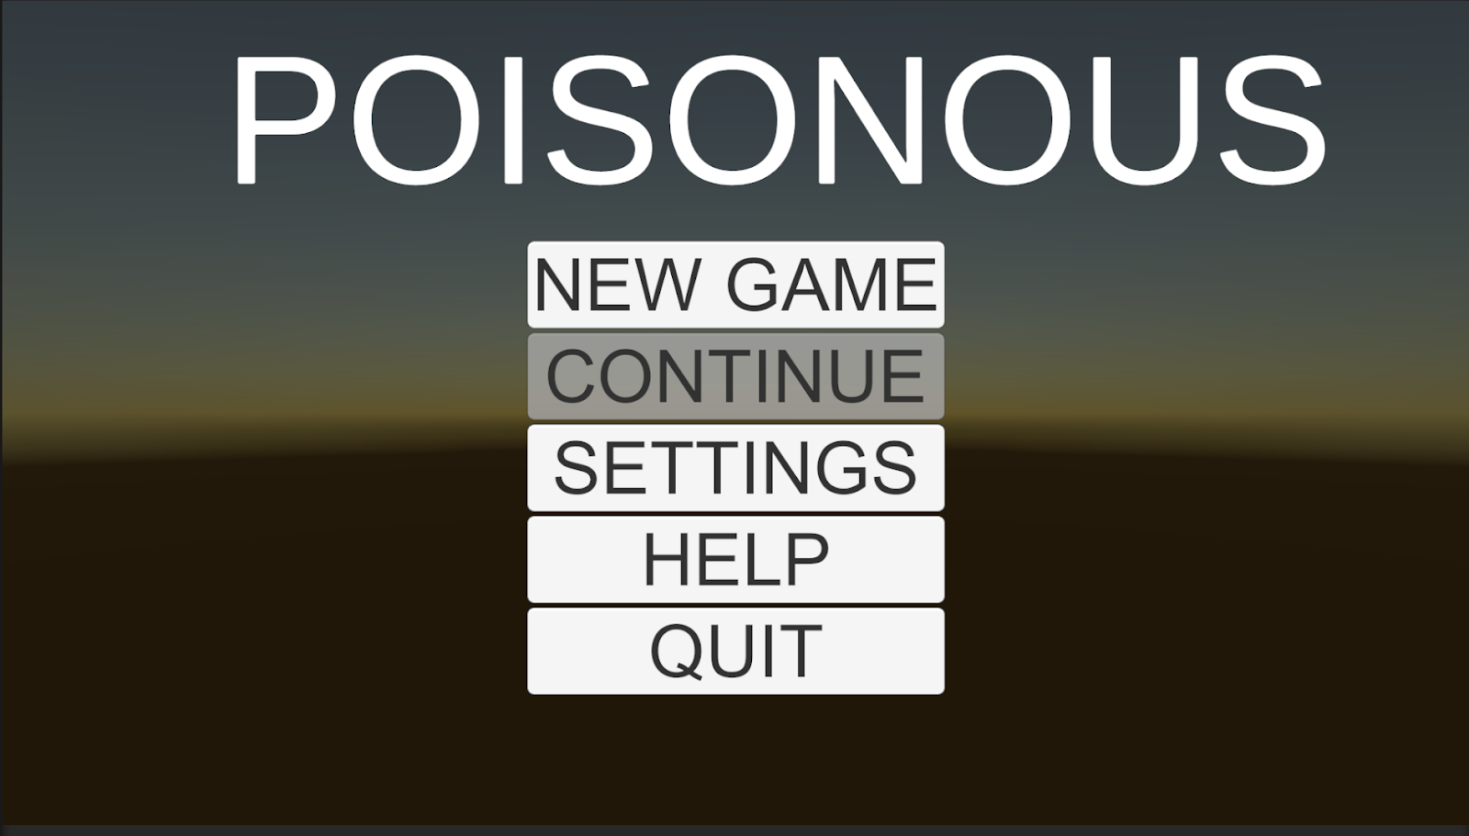
Introduction
Learning purpose of the course
Curiosity
Academic context

Slide 3
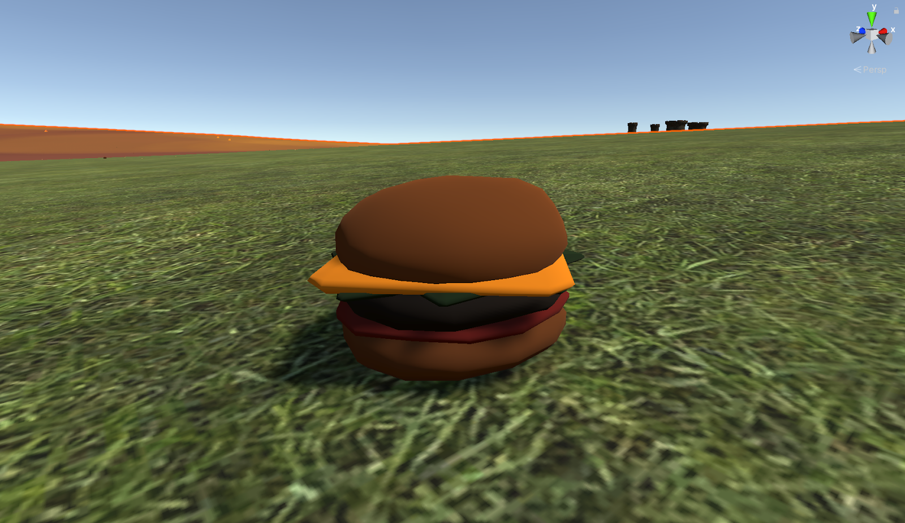
Requirements
3D Videogame
First/third person
Scene graph transformations
Static and dynamic objects
Material, textures
Audio effects
AI
Tutorial
Complete game

Slide 4
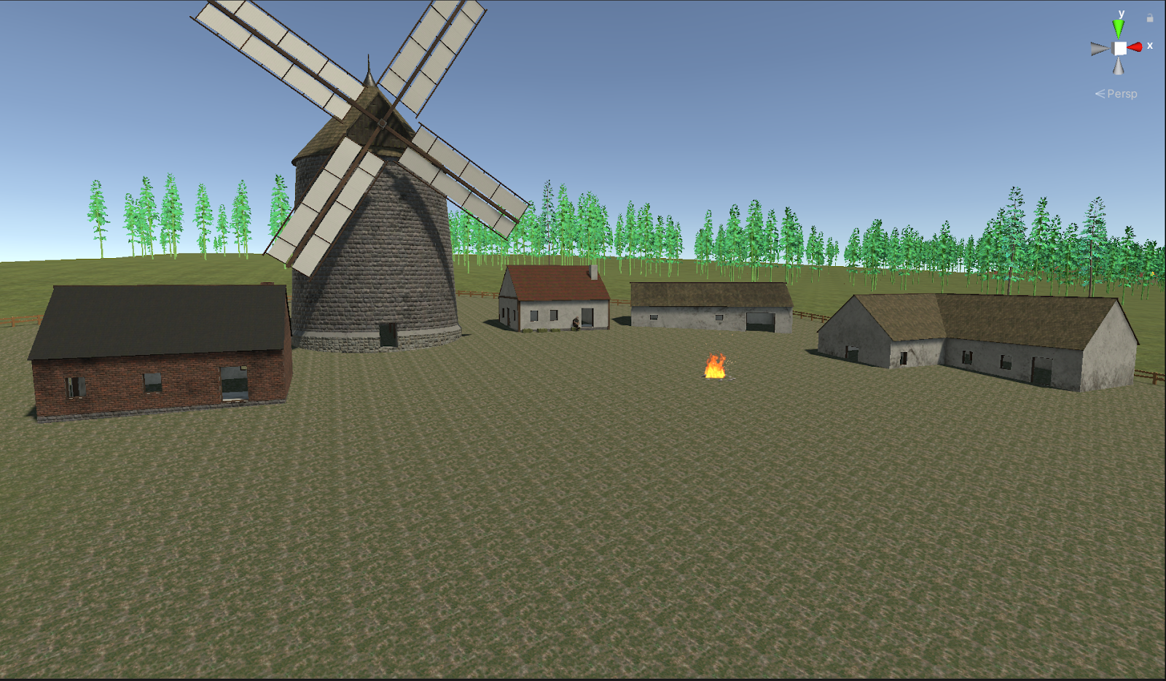
Idea/How to play
Survivor game
Interact with ambiental objects
2 type of zombies
Building system
2 difficulty levels

Slide 5
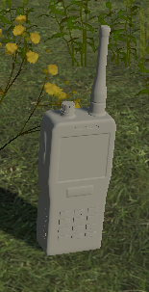
Transmission theme
Plane crashed
Part of antenna around the world
Take all pieces to go home.

Slide 6
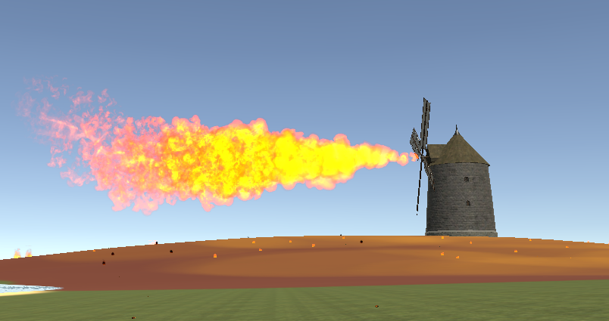
Architecture
Menu
World
Enemy
Player
Logic Behind
Items
Animations
Building system
Dialogue system
Weapon system
Day/Night cycle

Slide 7
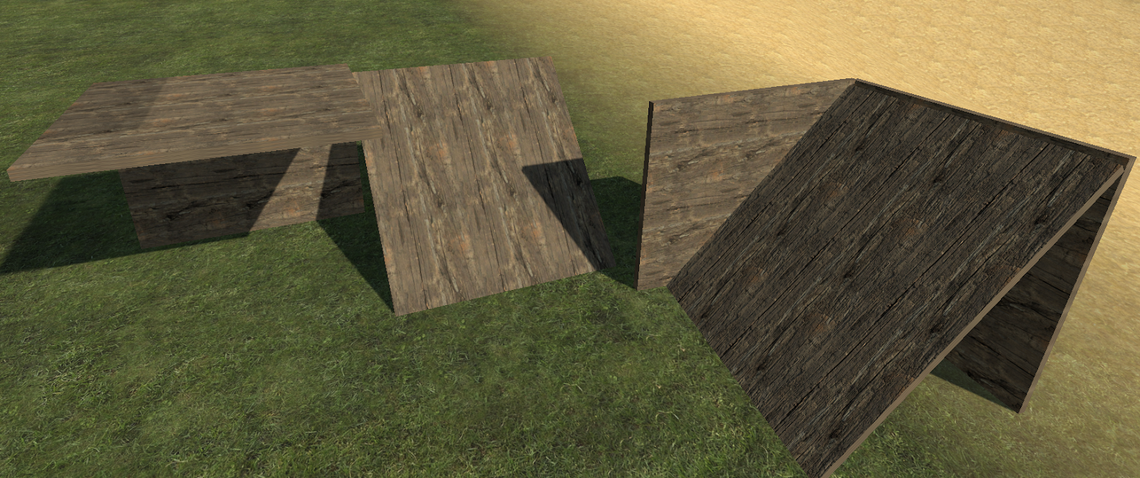
Implementation details
Building system
Enemy spawner
Dialogue system
Item spawner

Slide 8
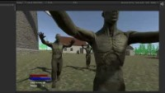
Demo

